Slide 1
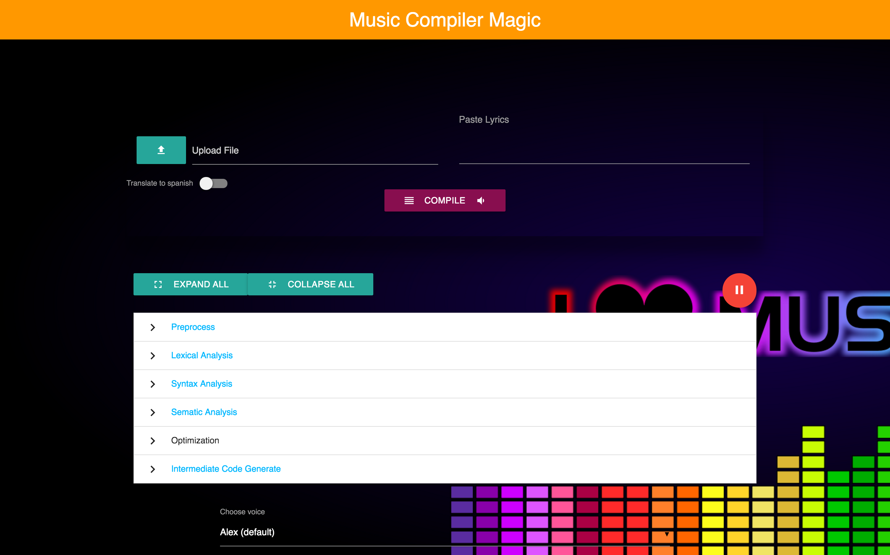
DPL Musical Compiler
Dimitri Harding
Sheyinka Harry
Andre Hutchinson
Megan Hutchinson

Slide 2
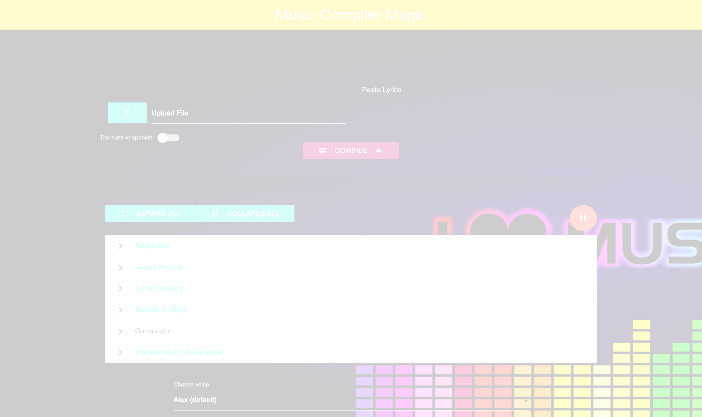
Coding Environment
The musical compiler was coded using the Node.js environment which allowed for the use of Javascript.
This platform was chosen as it presented the team with a “different” way of coding as well as it allowed the team to look at easier ways to implement the different phases of the compiler

Slide 3
Rules and Design Considerations
The following considerations were taken into account to ensure the accuracy of the compilation of the song lyrics

Slide 4
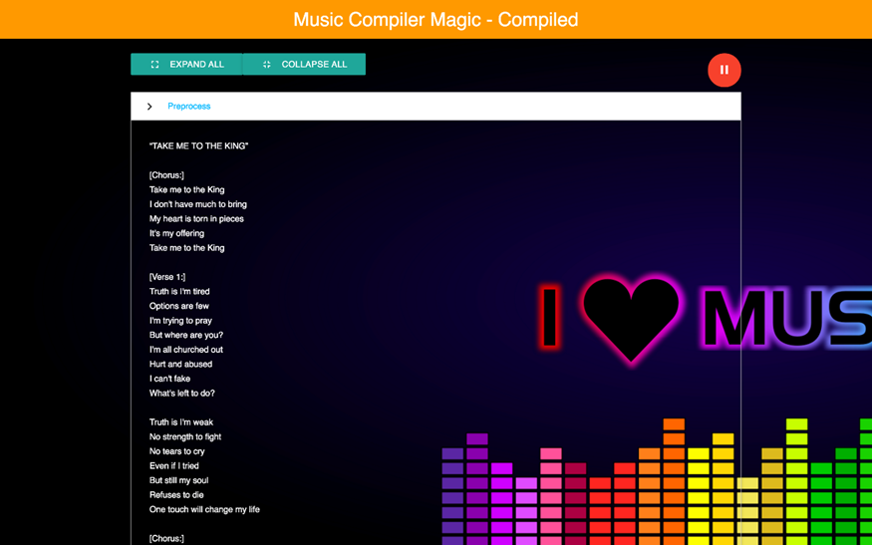
Preprocessor
If lines within the lyrics need to be replicated, the replication expression must be written with the ‘x’ before the figure stating the number of times the lines are to be repeated

Slide 5

Lexical Analysis
Should take into account all punctuations that can occur within song lyrics
Listing of tokens should be printed out in a list for easy manipulation by other phases
Should account for punctuations that fall in words
Should be able to subdivide lyrics and identify title of song, words within the song, and reconstruct these words into the original sentences
Should state the position of these different tokens

Slide 6
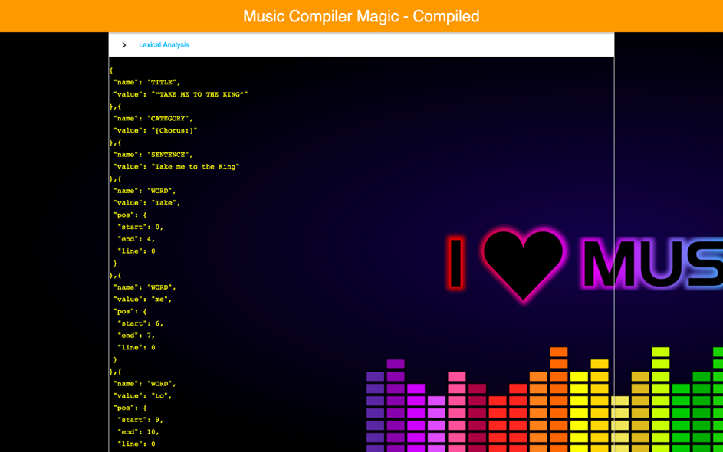
Lex Screenshot

Slide 7
Syntax Analysis
Should consult data dictionary to ensure that terms are properly capitalized e.g Gospel:- Lord, God, Jesus etc.
Title should be enclosed in quotes
All words must belong to the English language
Title of song should start the file

Slide 8
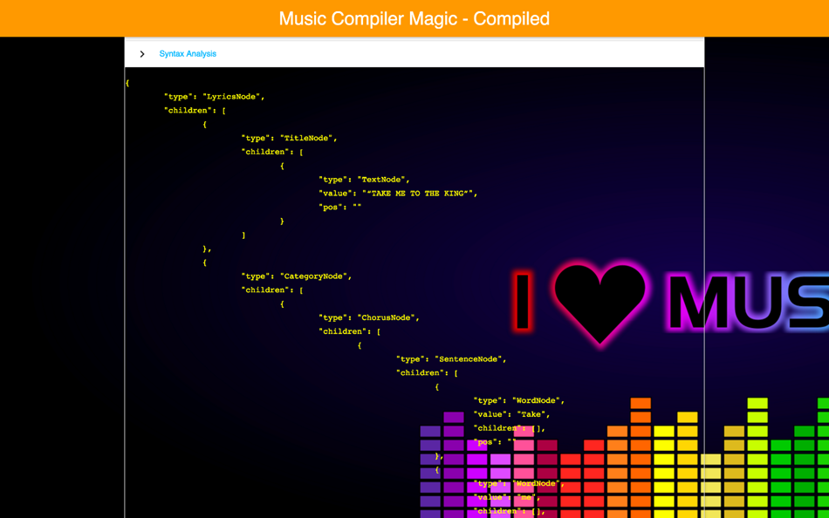
Syntax Screenshot

Slide 9
Semantic Analysis
Ensure that song layout follows one of the specified combinations
e.g Verse, Chorus, Verse, Bridge

Slide 10
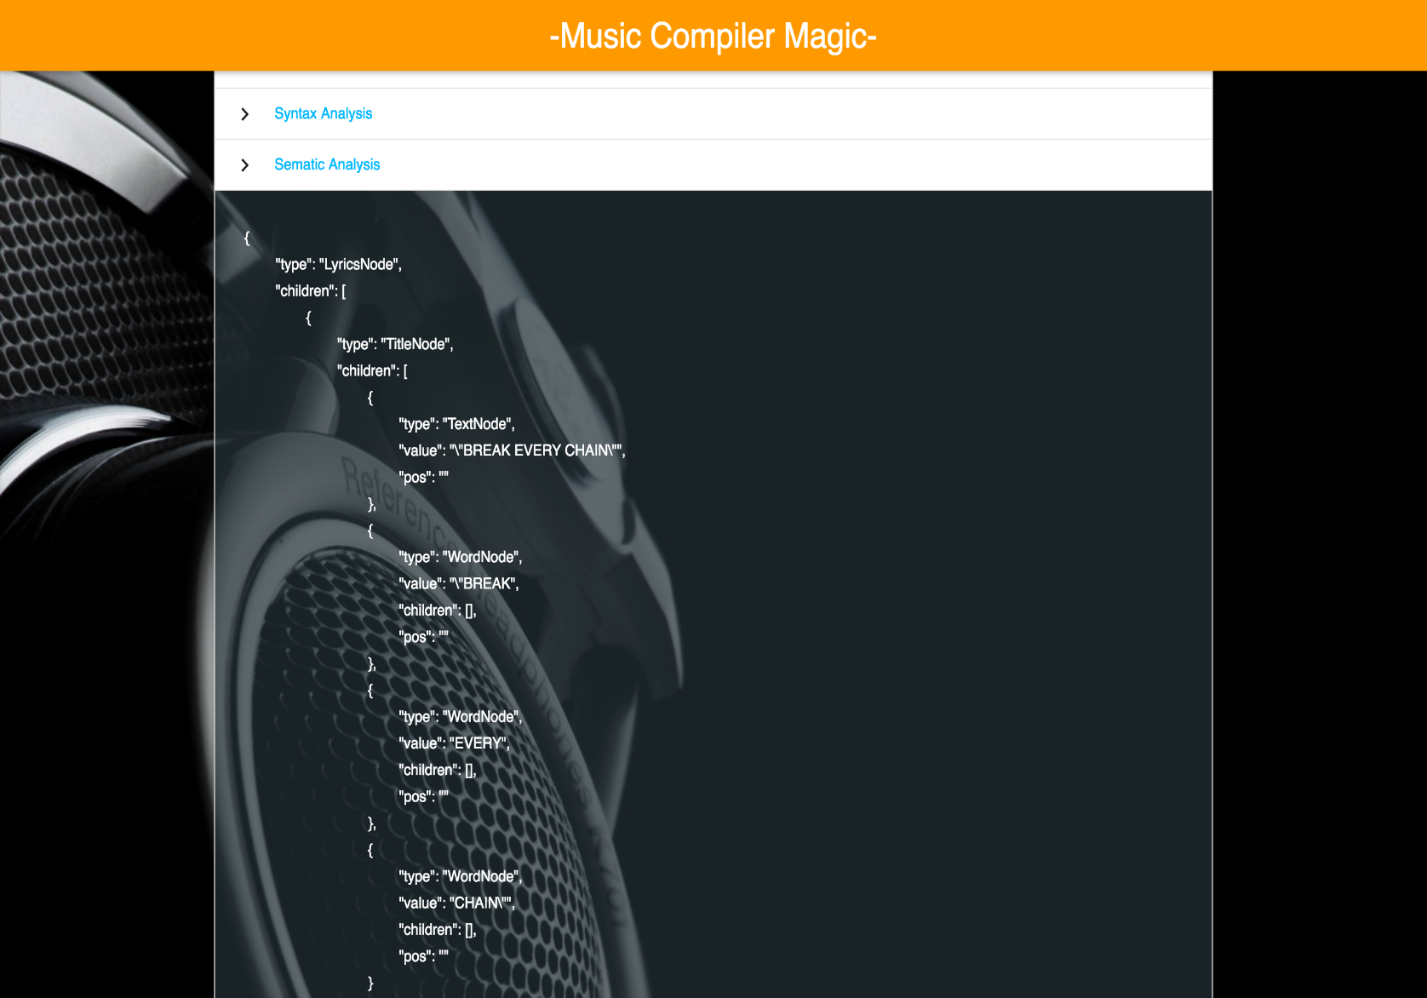
Semantic Phase Screenshot

Slide 11
Intermediate Code Generation
Convert data in the semantic analysis phase to ASCII values
If lyric line doesn’t end with a punctuation (?/!/.), insert a comma at the end

Slide 12
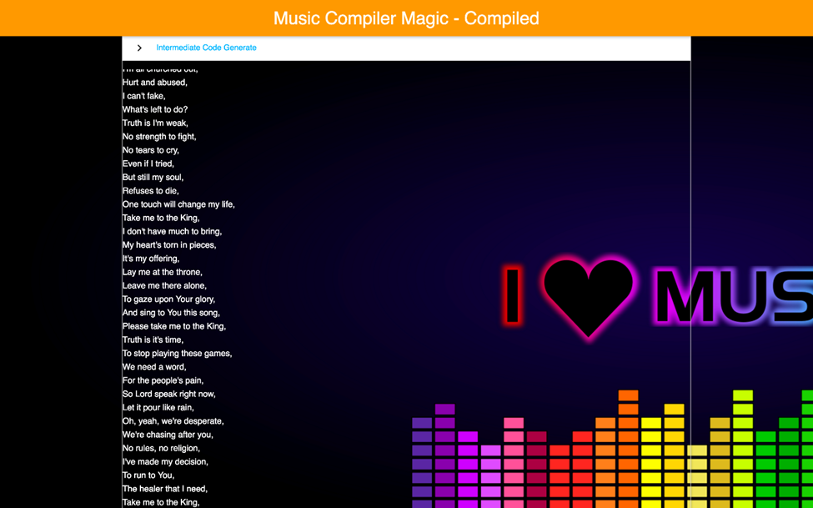
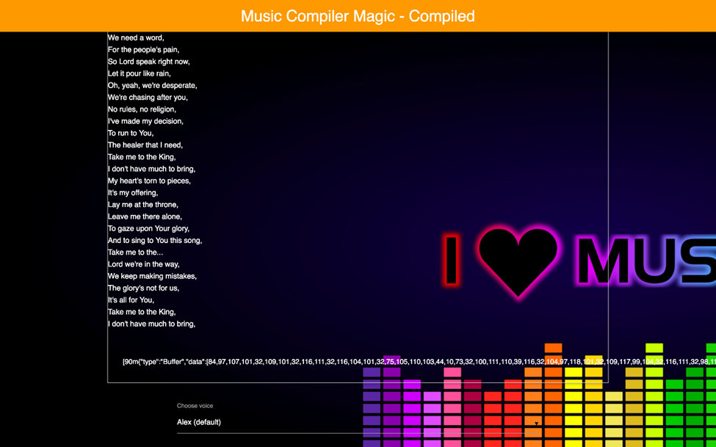
Intermediate Code Generation Screenshot
Addition of commas to end of lines where there were no punctuations
ASCII Representation of lyrics

Slide 13
Optimization
Remove identifiers enclosed in the ASCII representation of square brackets:- Check for open and closed square brackets and skip contents of it, inclusive of the brackets
Using Huffman Coding to compress the text file from the Intermediate Code Generation Phase

Slide 14
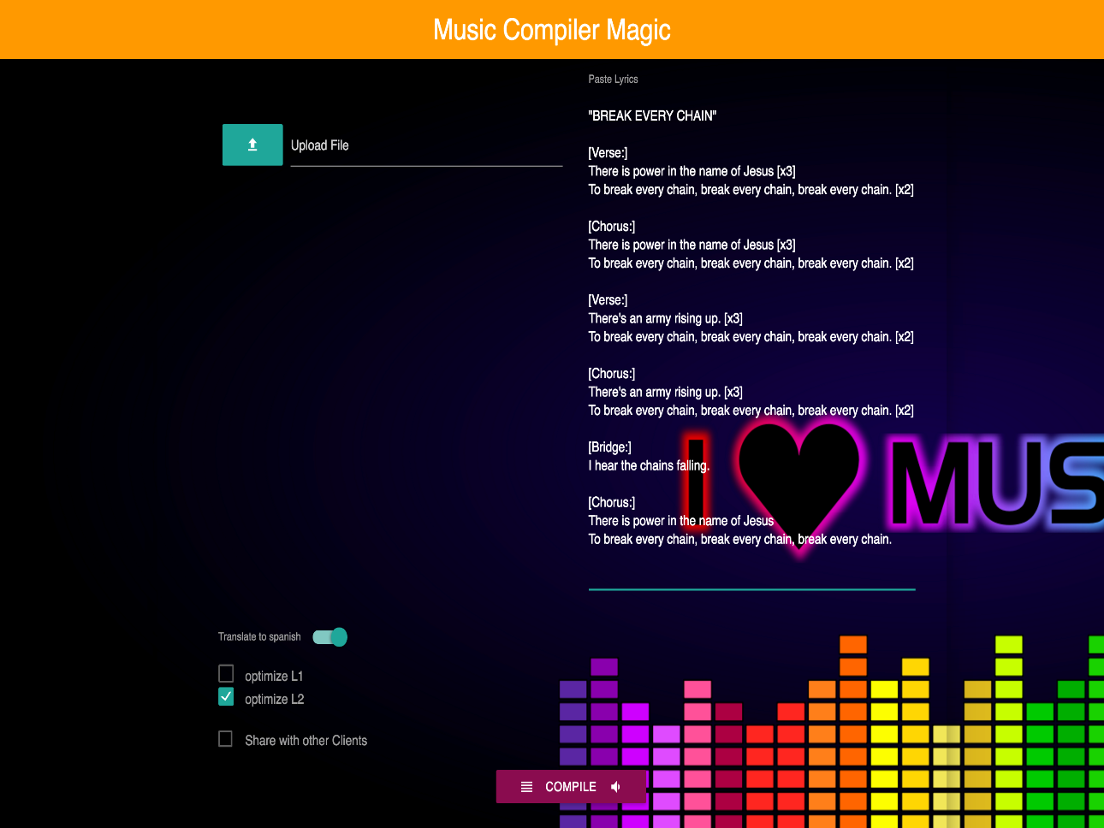
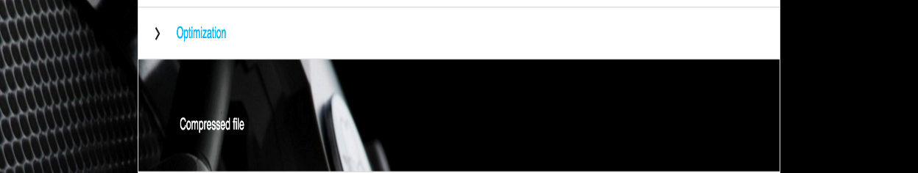
Optimization Screenshot

Slide 15
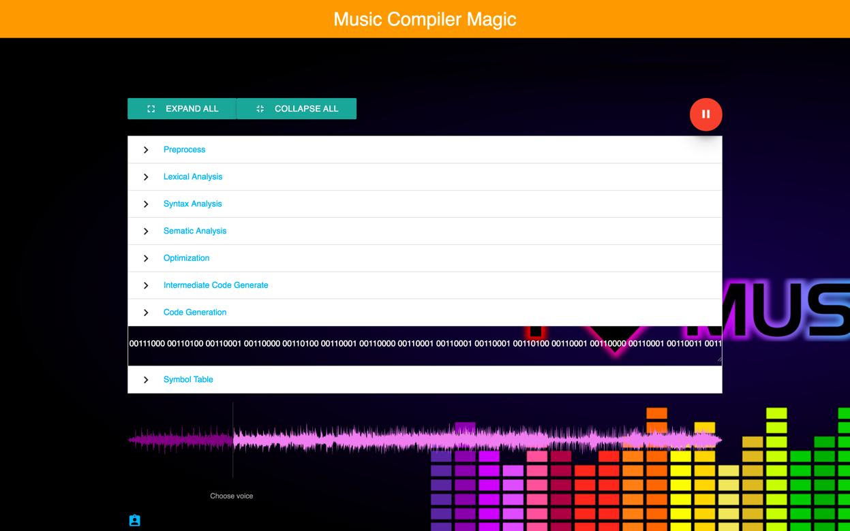
Code Generation Screenshot
This phase takes the optimized IR and then convert it to binary.

Slide 16
English to Spanish Conversion
Once the “Translate to Spanish” option is selected, the text that was inputted will be sent to the Google Chrome Translation API for the translation

Slide 17

Translation Screenshot

Slide 18
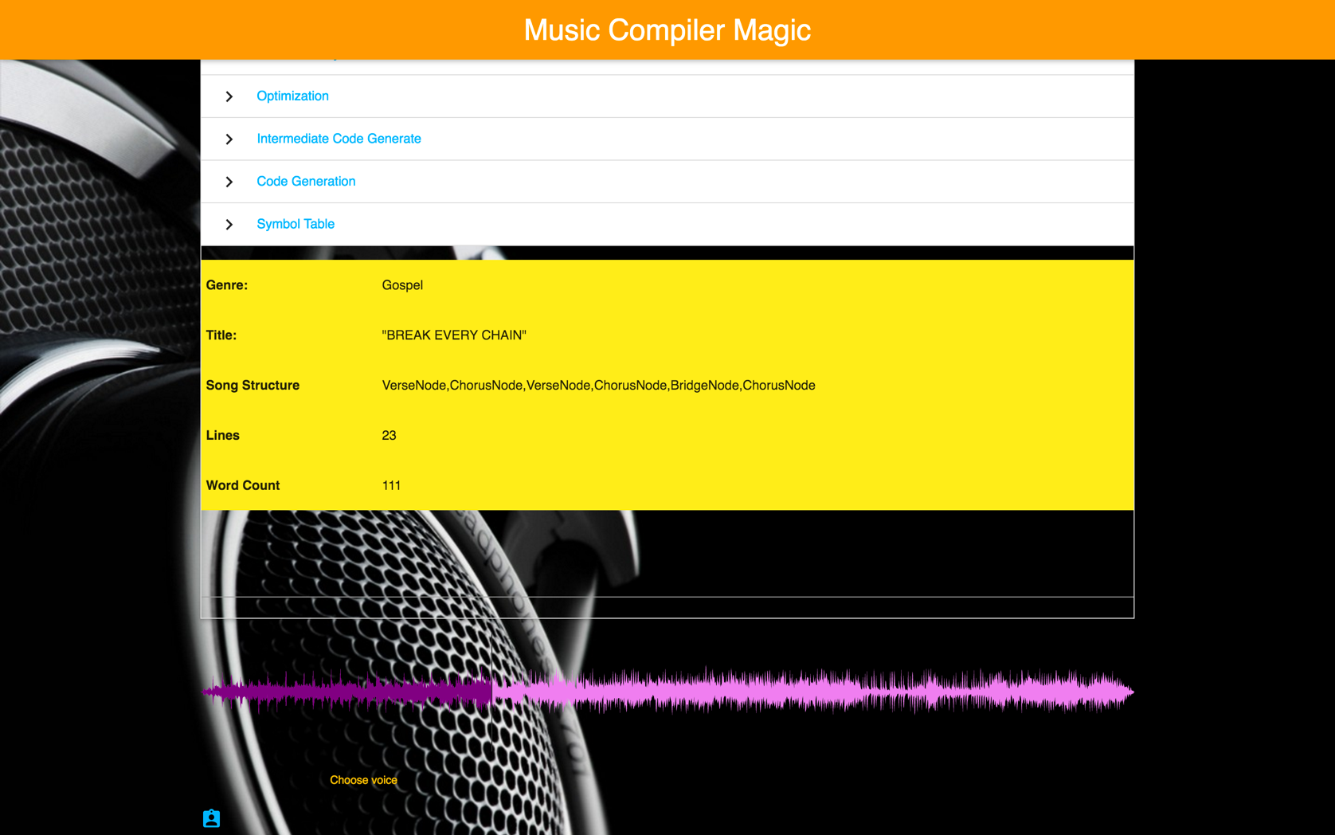
Symbol Table Output

